Slide 1
MODULE II CONSTRAINTS AND SQL COMMANDS Course Code: 23IT201 Course Title: DataBase Management Systems Academic Year: 2024 - 2025 (Even Sem)
SQL Commands-DDL,DML,TCL,DCL
MODULE 2 - CONSTRAINTS AND SQL COMMANDS

Slide 2
DDL Commands - Create, Drop, Alter, Truncate, Rename, Normalization - 1NF, 2NF, 3NF, BCNF, 4NF- DML Commands - Select, Insert, Update, Delete, Any, All, In, Exists, Non Exists, Union, Intersection, Subqueries - nested, correlated, Joins- Inner, Outer, and Equi, Functions - SUM, COUNT, AVG, MIN, MAX, Clauses - Group By, Having By, Embedded SQL, Dynamic SQL, Transaction Concepts – Transaction model – ACID Properties – Serializability
SQL Commands-DDL,DML,TCL,DCL
MODULE II CONSTRAINTS AND SQL COMMANDS
MODULE 2 - CONSTRAINTS AND SQL COMMANDS
2

Slide 3
SQL Commands-DDL,DML,TCL,DCL
SQL Constructs-DDL,DML,TCL,DCL
Topics to be Covered
Data Definition Language (DDL)
Data Manipulation Language (DML)
Transaction Control Language (TCL)
Data Control Language (DCL)
Data Manipulation Operations – Additional Basic Operations
Data Manipulation Operations – Set Operations
MODULE 2 - CONSTRAINTS AND SQL COMMANDS

Slide 4


SQL Commands-DDL,DML,TCL,DCL
Data Definition Language (DDL)
Component of Structured Query Language (SQL- Sequel)
Used for specifying database schema
Used to create and modify the structure of database objects in a database
Also known as Data Description Language
SQL – Case In-sensitive (case doesn’t matter. Eg., CREATE or create or cReatE)
DDL:
MODULE 2 - CONSTRAINTS AND SQL COMMANDS

Slide 5
SQL Commands-DDL,DML,TCL,DCL
Data Definition Language (DDL)
Commands in DDL
CREATE – To create database instance
DROP – To drop database instances
ALTER – To alter structure of database
RENAME – To rename database instances
TRUNCATE – To delete tables in a database instance
Naming Conventions For Table Name
First letter should be alphabet and Reserve word cannot be used
Maximum length for table name is 30 characters
Two different tables cannot have same name
Underscore, numerals & letters are allowed
Blank space and Single quotes are not allowed
MODULE 2 - CONSTRAINTS AND SQL COMMANDS

Slide 6


SQL Commands-DDL,DML,TCL,DCL
Data Definition Language (DDL)
Create Output
Creates database instance (object)
Data Type
Type of data to be stored in a field. E.g., int, float, date, time, char, varchar
Size
Total length of a data object in a field
Syntax
CREATE TABLE table_name(column1_name data_type(size),column2_name data_type(size),……………………………..);
E.g., CREATE TABLE students(id int,first_name varchar(15),last_name varchar(15),phone_no int,experience int);
MODULE 2 - CONSTRAINTS AND SQL COMMANDS

Slide 7
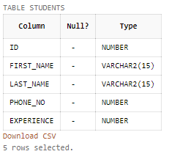
SQL Commands-DDL,DML,TCL,DCL
Data Definition Language (DDL)
Desc Output
To view the structure of the table
Syntax
DESC table_name;
E.g., DESC students;
MODULE 2 - CONSTRAINTS AND SQL COMMANDS

Slide 8
SQL Commands-DDL,DML,TCL,DCL
Data Definition Language (DDL)
Drop
Delete a database instance (object)
Used to remove a relation (base table) and its definition
The relation can no longer be used in queries, updates, or any other commands since its description no longer exists
Syntax
DROP TABLE table_name;
E.g., DROP TABLE students;
Output
DESC students;
MODULE 2 - CONSTRAINTS AND SQL COMMANDS

Slide 9

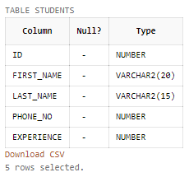
SQL Commands-DDL,DML,TCL,DCL
Data Definition Language (DDL)
Alter
Modify the structure of a table or database
Add new columns to a table
Change the data type or size of a column
Syntax
ALTER TABLE table_name MODIFY(column_name newdata_type(newsize));
E.g., ALTER TABLE students MODIFY (first_name varchar(20));
Output
DESC students;
MODULE 2 - CONSTRAINTS AND SQL COMMANDS

Slide 10
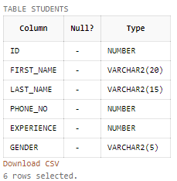
SQL Commands-DDL,DML,TCL,DCL
Data Definition Language (DDL)
Alter
Syntax
ALTER TABLE table_name ADD(column_name data_type(size));
E.g., ALTER TABLE students ADD(gender varchar(5));
Output
DESC students;
Restrictions on the Alter Table
Alter table cannot be used
to change name of the table
to change name of the column
to drop a column
to decrease size of a column if table data exists
MODULE 2 - CONSTRAINTS AND SQL COMMANDS

Slide 11
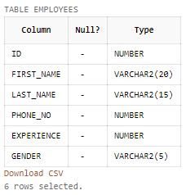
SQL Commands-DDL,DML,TCL,DCL
Data Definition Language (DDL)
Rename
To change the name of a table in a database
Syntax
RENAME oldtable_name TO newtable_name;
E.g., RENAME students TO employees;
Output
DESC employees;
MODULE 2 - CONSTRAINTS AND SQL COMMANDS

Slide 12

SQL Commands-DDL,DML,TCL,DCL
Data Definition Language (DDL)
Truncate
To delete all the data in a table without affecting table structure
Syntax
TRUNCATE TABLE table_name;
E.g., TRUNCATE TABLE employees;
Output
INSERT INTO employees VALUES('1','sindhu','karthi','9944714665','4','F');
SELECT * FROM employees;
MODULE 2 - CONSTRAINTS AND SQL COMMANDS

Slide 13
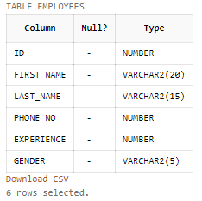
SQL Commands-DDL,DML,TCL,DCL
Data Definition Language (DDL)
Truncate
Output
TRUNCATE TABLE employees;
SELECT * FROM employees;
DESC employees;
MODULE 2 - CONSTRAINTS AND SQL COMMANDS

Slide 14
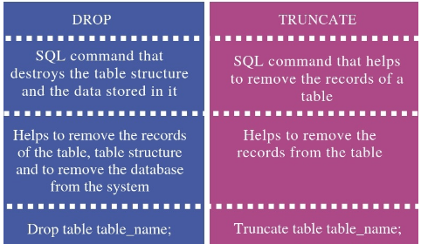
SQL Commands-DDL,DML,TCL,DCL
Data Definition Language (DDL)
Drop vs Truncate
The Difference between Drop and Truncate is as follows:
MODULE 2 - CONSTRAINTS AND SQL COMMANDS

Slide 15
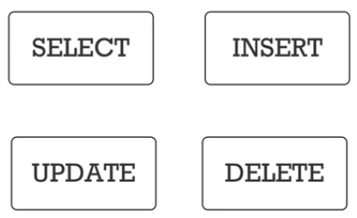
SQL Commands-DDL,DML,TCL,DCL
Data Manipulation Language (DML)
Component of Structured Query Language (SQL- Sequel)
Used for accessing and manipulating data in a database
Used to add, delete or modify an existing data in a table
Add a new data in a table
Change the data of a record in a table
Delete the data of a record in table
DML is of two types
Procedural deals with “what” and “how”. E.g., Relational Algebra
Non-Procedural deals with “what” only. E.g., Relational Calculus
DML:
MODULE 2 - CONSTRAINTS AND SQL COMMANDS

Slide 16
SQL Commands-DDL,DML,TCL,DCL
Data Manipulation Language (DML)
Commands in DML
SELECT – To read records from table(s)
INSERT – To insert record(s) into the table(s)
UPDATE – Update the data in table(s)
DELETE – Delete all the records from the tables
Select
Used to select a set of data or information from a table
Retrieve information or view a set of information
Used to query information from a table
Also known as Data Query Language (DQL)
Select command is used with different conditions and clauses
MODULE 2 - CONSTRAINTS AND SQL COMMANDS

Slide 17

SQL Commands-DDL,DML,TCL,DCL
Data Manipulation Language (DML)
Select
Clauses used are Select, From and Where
Note: The table should not be empty (If the table is empty, it will give an error)
Select Clause & From Clause
Select clause lists the attributes desired in the result of a query
Syntax 1
SELECT column1_name,column2_name,…….. FROM table_name;
E.g., SELECT id,first_name,last_name FROM students;
Output
MODULE 2 - CONSTRAINTS AND SQL COMMANDS

Slide 18
SQL Commands-DDL,DML,TCL,DCL
Data Manipulation Language (DML)
Select Clause & From Clause
From clause lists the relations involved in the query
Syntax 2
SELECT * FROM table_name;
E.g., SELECT * FROM students;
Output
MODULE 2 - CONSTRAINTS AND SQL COMMANDS

Slide 19
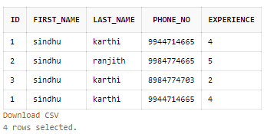

SQL Commands-DDL,DML,TCL,DCL
Data Manipulation Language (DML)
Where Clause
Where clause specifies conditions that the result must satisfy
Syntax 1
SELECT column_name FROM table_name WHERE condition;
E.g., SELECT id FROM students WHERE experience=2;
Output
Before After
MODULE 2 - CONSTRAINTS AND SQL COMMANDS

Slide 20

SQL Commands-DDL,DML,TCL,DCL
Data Manipulation Language (DML)
Where Clause
Syntax 2
SELECT * FROM table_name WHERE condition;
E.g., SELECT * FROM students WHERE experience=2;
Output
Before After
MODULE 2 - CONSTRAINTS AND SQL COMMANDS

Slide 21

SQL Commands-DDL,DML,TCL,DCL
Data Manipulation Language (DML)
Insert
Used to add new records or rows to a table
Syntax 1
INSERT INTO table_name(column1_name,column2_name,……………) VALUES(value1,value2,…………………….);
Note: Order of the columns in the table does not matter. We can write it any ways
E.g., INSERT INTO students(id,first_name,last_name,phone_no,experience) VALUES('1','sindhu','karthi','9944714665','4');
Output
SELECT * FROM students;
MODULE 2 - CONSTRAINTS AND SQL COMMANDS

Slide 22
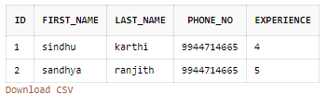
SQL Commands-DDL,DML,TCL,DCL
Data Manipulation Language (DML)
Insert
Syntax 2
INSERT INTO table_name VALUES(value1,value2,………………);
Note: Values are automatically added to the columns in the table. Order of the columns in the table matters. We have to remember the order of the table.
E.g., INSERT INTO students VALUES('1','sindhu','karthi','9944714665','4');
Output
SELECT * FROM students;
MODULE 2 - CONSTRAINTS AND SQL COMMANDS

Slide 23

SQL Commands-DDL,DML,TCL,DCL
Data Manipulation Language (DML)
Update
Used to change or modify data in a table
Note: WHERE clause is very important
Syntax
UPDATE table_name SET column_name1=value1,column2_name2=value2, ……………………………… WHERE condition;
E.g., UPDATE students SET phone_no=8015491040 WHERE id=2;
Output
SELECT * FROM students;
MODULE 2 - CONSTRAINTS AND SQL COMMANDS

Slide 24

SQL Commands-DDL,DML,TCL,DCL
Data Manipulation Language (DML)
Delete
Used to delete a record or a data from a table
Note: WHERE clause is very important. If WHERE clause is not included, all the data in the table will be deleted
Syntax
DELETE FROM table_name WHERE condition;
E.g., DELETE FROM students WHERE id=2;
Output
SELECT * FROM students;
MODULE 2 - CONSTRAINTS AND SQL COMMANDS

Slide 25
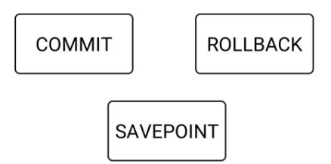
SQL Commands-DDL,DML,TCL,DCL
Transaction Control Language (TCL)
Component of SQL used to manage transactions in a database
Used to manage changes made to the data in a table by DML statements
Also allows statements to be grouped together into logical transactions
TCL control transactions in a table
Transactions are any operation performed on a table using DML
TCL:
MODULE 2 - CONSTRAINTS AND SQL COMMANDS

Slide 26
SQL Commands-DDL,DML,TCL,DCL
Transaction Control Language (TCL)
Rollback
Used to get back to the previous permanent status of the table
Database state is restored to what it was before the first statement of the transaction was executed
Similar to undo command
Note: Table can be rolled-back only if it is temporary. If committed the changes, it cannot be rolled-back
Syntax
ROLLBACK TO savepoint_name;
MODULE 2 - CONSTRAINTS AND SQL COMMANDS

Slide 27
SQL Commands-DDL,DML,TCL,DCL
Transaction Control Language (TCL)
Savepoint
Used along with the rollback command to mark a transaction in a table
A transaction can be named using this command
Similar to bookmarks
Syntax
SAVEPOINT savepoint_name;
Commit
Used to save the changes made to the table permanently
After the transaction is committed, a new transaction is automatically started
Syntax
COMMIT;
MODULE 2 - CONSTRAINTS AND SQL COMMANDS

Slide 28
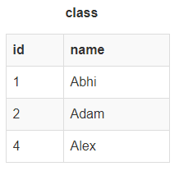
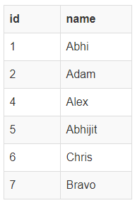
SQL Commands-DDL,DML,TCL,DCL
Transaction Control Language (TCL)
E.g.,
INSERT INTO class VALUES(5, 'Rahul');
COMMIT;
UPDATE class SET name = 'Abhijit' WHERE id = '5';
SAVEPOINT A;
INSERT INTO class VALUES(6, 'Chris');
SAVEPOINT B;
INSERT INTO class VALUES(7, 'Bravo');
SAVEPOINT C;
SELECT * FROM class;
Output
MODULE 2 - CONSTRAINTS AND SQL COMMANDS

Slide 29
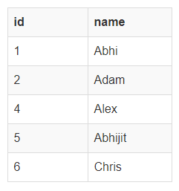
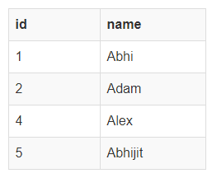
SQL Commands-DDL,DML,TCL,DCL
Transaction Control Language (TCL)
E.g.,
ROLLBACK TO B;
SELECT * FROM class;
ROLLBACK TO A;
SELECT * FROM class;
Output
MODULE 2 - CONSTRAINTS AND SQL COMMANDS

Slide 30

SQL Commands-DDL,DML,TCL,DCL
Data Control Language (DCL)
Used to control user access to data stored in a database
Component of SQL which is related to the security issues of a database
Privileges are of two types
System: Includes permissions for creating session, table, etc and all types of other system privileges
Object: Includes permissions for any command or query to perform any operation on the database tables
Commands of DCL
Grant: Used to give permission to a user to access a database
Revoke: Used to withdraw permission from a user to access a database
DCL:
MODULE 2 - CONSTRAINTS AND SQL COMMANDS

Slide 31
SQL Commands-DDL,DML,TCL,DCL
Data Control Language (DCL)
Allow a User to create session: To grant the session creating privileges
Syntax
GRANT CREATE SESSION TO username;
Allow a User to create table: To allow a user to create tables in the database
Syntax
GRANT CREATE TABLE TO username;
Grant all privilege to a User: sysdba is a set of priviliges which has all the permissions in it
Syntax
GRANT sysdba TO username;
MODULE 2 - CONSTRAINTS AND SQL COMMANDS

Slide 32
SQL Commands-DDL,DML,TCL,DCL
Data Control Language (DCL)
Provide user with space on tablespace to store table
Allowing a user to create table is not enough to start storing data in that table
Provide user with privileges to use available tablespace for their table & data
Syntax
ALTER USER username QUOTA UNLIMITED ON SYSTEM;
The above command will alter the user details and will provide it access to unlimited tablespace on system
Note: Generally unlimited quota is provided to Admin users
To prevent a user from creating table in a database
Syntax
REVOKE CREATE ANY TABLE TO username;
MODULE 2 - CONSTRAINTS AND SQL COMMANDS

Slide 33
SQL Commands-DDL,DML,TCL,DCL
Data Control Language (DCL)
Grant permission to create any table: Grant privileges to a user to create any table
Syntax
GRANT CREATE ANY TABLE TO username;
Grant permission to drop any table: Allow user to drop any table from the database
Syntax
GRANT DROP ANY TABLE TO username;
To take back Permissions: To take back the privileges from any user
Syntax
REVOKE CREATE TABLE FROM username;
MODULE 2 - CONSTRAINTS AND SQL COMMANDS

Slide 34
SQL Commands-DDL,DML,TCL,DCL
Data Manipulation Operations – Additional Basic Operations
The Rename Operation
Uses the as clause which can appear in both the select and from clauses
Syntax
old-name AS new-name
E.g. 1, “For renaming the attribute name name with the name instructor name”
SELECT name AS instructor name, course id FROM instructor, teaches WHERE instructor.ID= teaches.ID;
E.g. 2, “For all instructors in the university who have taught some course, find their names and the course ID of all courses they taught”
SELECT T.name, S.course id FROM instructor AS T, teaches AS S where T.ID= S.ID;
Module 1 – DataBase System Architecture
MODULE 2 - CONSTRAINTS AND SQL COMMANDS
34

Slide 35
SQL Commands-DDL,DML,TCL,DCL
Data Manipulation Operations – Additional Basic Operations
The Rename Operation
E.g. 3, “Find the names of all instructors whose salary is greater than at least one instructor in the Biology department”
SELECT DISTINCT T.name FROM instructor AS T, instructor AS S WHERE T.salary > S.salary AND S.dept name = ’Biology’;
Attribute Specification in Select Clause
Asterisk symbol “ * ” can be used in the select clause to denote “all attributes”
E.g., SELECT instructor.* FROM instructor, teaches WHERE instructor.ID= teaches.ID;
Module 1 – DataBase System Architecture
MODULE 2 - CONSTRAINTS AND SQL COMMANDS
35

Slide 36
SQL Commands-DDL,DML,TCL,DCL
Data Manipulation Operations – Additional Basic Operations
Where Clause Predicates
Includes a between comparison operator to simplify where clauses that specify that a value be less than or equal to some value and greater than or equal to some other value
E.g. , “To find the names of instructors with salary amounts between $90,000 and $100,000”
SELECT name FROM instructor WHERE salary BETWEEN 90000 AND 100000;
MODULE 2 - CONSTRAINTS AND SQL COMMANDS
36

Slide 37
SQL Commands-DDL,DML,TCL,DCL
Data Manipulation Operations – Additional Basic Operations
String Operations
SQL specifies strings by enclosing them in single quotes E.g., ‘Computer’
Single quote character that is part of a string can be specified by using two single quote characters E.g., “It’s right” can be specified by “It”s right”
SQL also permits a variety of functions on character strings
concatenating (using “||”)
extracting substrings
finding the length of strings
converting strings to uppercase (using the function upper(s) where s is a string) and lowercase (using the function lower(s))
removing spaces at the end of the string (using trim(s)) and so on
Module 1 – DataBase System Architecture
MODULE 2 - CONSTRAINTS AND SQL COMMANDS
37

Slide 38
SQL Commands-DDL,DML,TCL,DCL
Data Manipulation Operations – Additional Basic Operations
String Operations
Pattern matching can be performed on strings, using the operator like
Describe patterns by using two special characters
Percent (%): The % character matches any substring
Underscore (_): The character matches any character
Patterns are case sensitive E.g., ‘Intro%’ matches any string beginning with “Intro”
‘%Comp%’ matches any string containing “Comp” as a substring E.g., ‘Intro. to Computer Science’, and ‘Computational Biology’
‘_ _ _’ matches any string of exactly three characters
‘_ _ _%’ matches any string of at least three characters
Module 1 – DataBase System Architecture
MODULE 2 - CONSTRAINTS AND SQL COMMANDS
38

Slide 39
SQL Commands-DDL,DML,TCL,DCL
Data Manipulation Operations – Additional Basic Operations
String Operations
E.g., SELECT dept name FROM department WHERE building LIKE ‘%Watson%’
The escape character (\) is used immediately before a special pattern character to indicate that the special pattern character is to be treated like a normal character
E.g. 1, like ’ab\%cd%’ escape ’\’ matches all strings beginning with “ab%cd”
E.g. 2, like ’ab\\cd%’ escape ’\’ matches all strings beginning with “ab\cd”
Module 1 – DataBase System Architecture
MODULE 2 - CONSTRAINTS AND SQL COMMANDS
39

Slide 40
SQL Commands-DDL,DML,TCL,DCL
Data Manipulation Operations – Additional Basic Operations
The Order By Clause
Offers the user some control over the order to display tuples in a relation
Order by clause arranges the tuples in the result of a query in sorted order
E.g. 1, “To list in alphabetic order all instructors in the Physics department”
SELECT name FROM instructor WHERE dept name = ‘Physics’ ORDER BY name;
E.g. 2, “To list the entire instructor relation in descending order of salary, if several instructors have the same salary, then order them in ascending order by name”
SELECT * FROM instructor ORDER BY salary DESC, name ASC;
Module 1 – DataBase System Architecture
MODULE 2 - CONSTRAINTS AND SQL COMMANDS
40

Slide 41
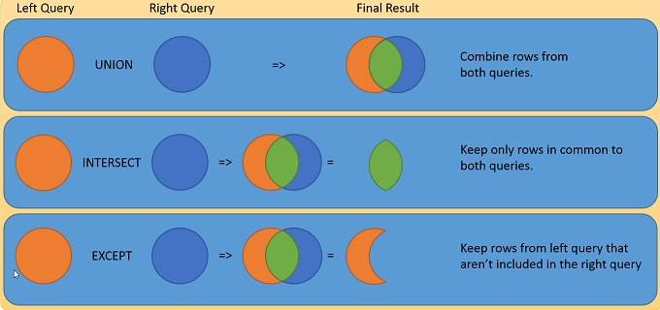
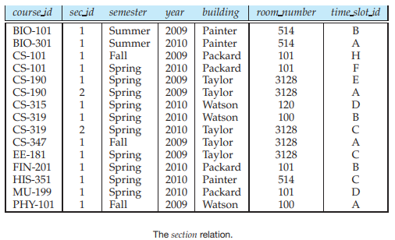
SQL Commands-DDL,DML,TCL,DCL
Data Manipulation Operations – Set Operations
Union, Intersect, and Except operate on relations and correspond to the mathematical set-theory operations ∪, ∩, and − over two sets
Set Operations: Part 1: Part 2: Part 3:
Module 1 – DataBase System Architecture
MODULE 2 - CONSTRAINTS AND SQL COMMANDS
41

Slide 42

SQL Commands-DDL,DML,TCL,DCL
Data Manipulation Operations – Set Operations
The Union Operation (∪)
Automatically eliminates duplicates, unlike the select clause
E.g., “To find the set of all courses taught either in Fall 2009 or in Spring 2010, or both”
(SELECT course id FROM section WHERE semester = ‘Fall’ AND year= 2009) UNION (SELECT course id FROM section WHERE semester = ‘Spring’ AND year= 2010);
Output
To retain all duplicates, use union all in place of union
E.g., (SELECT course id FROM section WHERE semester = ‘Fall’ AND year= 2009) UNION ALL (SELECT course id FROM section WHERE semester = ‘Spring’ AND year= 2010);
Module 1 – DataBase System Architecture
MODULE 2 - CONSTRAINTS AND SQL COMMANDS
42

Slide 43

SQL Commands-DDL,DML,TCL,DCL
Data Manipulation Operations – Set Operations
The Intersect Operation (∩)
“To find the set of all courses taught in the Fall 2009 as well as in Spring 2010”
E.g., (SELECT course id FROM section WHERE semester = ‘Fall’ AND year= 2009) INTERSECT (SELECT course id FROM section WHERE semester = ‘Spring’ AND year= 2010);
To retain all duplicates, use intersect all in place of intersect
E.g., (SELECT course id FROM section WHERE semester = ‘Fall’ AND year= 2009) INTERSECT ALL (SELECT course id FROM section WHERE semester = ‘Spring’ AND year= 2010);
Output
Module 1 – DataBase System Architecture
MODULE 2 - CONSTRAINTS AND SQL COMMANDS
43

Slide 44

SQL Commands-DDL,DML,TCL,DCL
Data Manipulation Operations – Set Operations
The Except Operation (-)
Performs set difference
“To find all courses taught in the Fall 2009 semester but not in the Spring 2010 semester”
E.g., (SELECT course id FROM section WHERE semester = ’Fall’ AND year= 2009) EXCEPT (SELECT course id FROM section WHERE semester = ’Spring’ AND year= 2010);
To retain duplicates, use except all in place of except
E.g., (SELECT course id FROM section WHERE semester = ’Fall’ AND year= 2009) EXCEPT ALL (SELECT course id FROM section WHERE semester = ’Spring’ AND year= 2010);
Output
Module 1 – DataBase System Architecture
MODULE 2 - CONSTRAINTS AND SQL COMMANDS
44

Slide 45
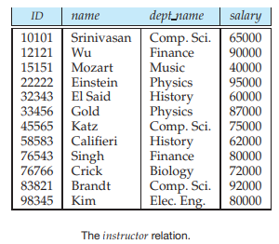
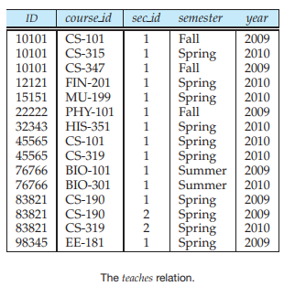
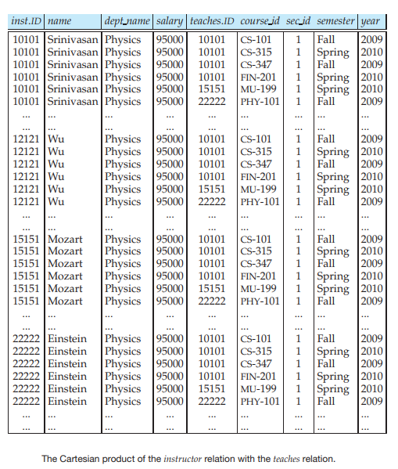
SQL Commands-DDL,DML,TCL,DCL
Data Manipulation Operations – Set Operations
Cartesian Product
Combines tuples from two tables that are unrelated to each other
Each tuple in first table is combined with every tuple in second table
E.g., SELECT * FROM instructor, teaches WHERE instructor.ID= teaches.ID;
Output
Module 1 – DataBase System Architecture
MODULE 2 - CONSTRAINTS AND SQL COMMANDS
45

Slide 46
SQL Commands-DDL,DML,TCL,DCL
Data Manipulation Operations – Set Operations
Present special problems in relational operations, including arithmetic operations, comparison operations, and set operations
The result of an arithmetic expression (involving, for example +, −, ∗, or /) is null if any of the input values is null
Comparisons involving nulls are more of a problem
“To find all instructors who appear in the instructor relation with null values for salary”
E.g., SELECT name FROM instructor WHERE salary IS NULL;
Module 1 – DataBase System Architecture
MODULE 2 - CONSTRAINTS AND SQL COMMANDS
46

Slide 47
SQL Commands-DDL,DML,TCL,DCL
Data Manipulation Operations – Set Operations
Functions that take a collection (a set or multiset) of values as input and return a single value
Average: avg
Minimum: min
Maximum: max
Total: sum
Count: count
“Find the average salary of instructors in the Computer Science department”
E.g., SELECT AVG (salary) FROM instructor WHERE dept name= ’Comp. Sci.’;
Aggregate Functions:
Module 1 – DataBase System Architecture
MODULE 2 - CONSTRAINTS AND SQL COMMANDS
47

Slide 48
SQL Commands-DDL,DML,TCL,DCL
Data Manipulation Operations – Set Operations
The Group By Clause
To apply the aggregate function to a single or a group of sets of tuples
“To find the average salary in each department”
E.g., SELECT dept name, AVG (salary) AS avg salary FROM instructor GROUP BY dept name;
The Having Clause
Useful to state a condition that applies to groups rather than to tuples
“To find only the departments where the average salary of the instructors is more than $42,000”
E.g., SELECT dept name, AVG (salary) AS avg salary FROM instructor GROUP BY dept name HAVING AVG (salary) > 42000;
Module 1 – DataBase System Architecture
MODULE 2 - CONSTRAINTS AND SQL COMMANDS
48

Slide 49
SQL Commands-DDL,DML,TCL,DCL
Data Manipulation Operations – Set Operations
A subquery is a select-from-where expression that is nested within another query
in and not in operators can also be used on enumerated sets
Subqueries in the Where Clause
“To find all the courses taught in the Fall 2009 semester and also in the Spring 2010 semester”
E.g. 1, SELECT DISTINCT course id FROM section WHERE semester = ’Fall’ AND year= 2009 AND course id IN (SELECT course id FROM section WHERE semester = ’Spring’ AND year= 2010);
“To find all the courses taught in the Fall 2009 semester but not in the Spring 2010 semester”
Module 1 – DataBase System Architecture
MODULE 2 - CONSTRAINTS AND SQL COMMANDS
49

Slide 50
SQL Commands-DDL,DML,TCL,DCL
Data Manipulation Operations – Set Operations
Subqueries in the Where Clause
E.g. 2, SELECT DISTINCT course id FROM section WHERE semester = ’Fall’ AND year= 2009 AND course id NOT IN (SELECT course id FROM section WHERE semester = ’Spring’ AND year= 2010);
Subqueries in the From Clause
“To find the average instructors’ salaries of those departments where the average salary is greater than $42,000” without using the having clause
E.g., SELECT dept name, AVG salary FROM (SELECT dept name, AVG (salary) AS avg_salary FROM instructor GROUP BY dept name) WHERE avg_salary > 42000;
MODULE 2 - CONSTRAINTS AND SQL COMMANDS
50

Slide 51
SQL Commands-DDL,DML,TCL,DCL
Data Manipulation Operations – Set Operations
The with Clause
Provides a way of defining a temporary relation whose definition is available only to the query in which the with clause occurs
“To finds those departments with the maximum budget”
E.g., WITH max_budget (value) AS (SELECT max(budget) FROM department) SELECT budget FROM department, max_budget WHERE department.budget = max_budget.value;
Nested Subqueries:
MODULE 2 - CONSTRAINTS AND SQL COMMANDS
51

Slide 52
SQL Commands-DDL,DML,TCL,DCL
SQL Constructs-DDL,DML,TCL,DCL
Summary
Data Definition Language (DDL)
Data Manipulation Language (DML)
Transaction Control Language (TCL)
Data Control Language (DCL)
Data Manipulation Operations – Additional Basic Operations
Data Manipulation Operations – Set Operations
MODULE 2 - CONSTRAINTS AND SQL COMMANDS

Slide 53
SQL Commands-DDL,DML,TCL,DCL
SQL Constructs-DDL,DML,TCL,DCL
Try Yourself
Use DDL commands to create and modify the following tables
Person (driverid, name, address, phoneno, age)
Car (license, model, year)
Accident (reportno, date, location)
Product (manufacturer, modelno, type)
Laptop (modelno, speed, ram size, hard disk size, screen, price)
Book (title, author, publisher, category, year, price)
Distributor (distid, distname, city, discount)
MODULE 2 - CONSTRAINTS AND SQL COMMANDS

Slide 54
SQL Commands-DDL,DML,TCL,DCL
SQL Constructs-DDL,DML,TCL,DCL
Try Yourself
Use DML commands to add, delete or modify the data in the following tables
Person (driverid, name, address, phoneno, age)
Car (license, model, year)
Accident (reportno, date, location)
Product (manufacturer, modelno, type)
Laptop (modelno, speed, ram size, hard disk size, screen, price)
Book (title, author, publisher, category, year, price)
Distributor (distid, distname, city, discount)
MODULE 2 - CONSTRAINTS AND SQL COMMANDS

